Slide 1
Lecture 3:
* B-physics experiments
* time-dependent CP-violation

Slide 2
Learning goals
B-physics experiments
CP violation in ‘the interference between mixing and decay’

Slide 3
Essentials for “quark flavour” physics
”decay vertex resolution”
“momentum resolution”
“particle ID”

Slide 4
Essentials for “quark flavour” physics
”decay vertex resolution”
  to identify weak decays
  to measure decaytime
“momentum resolution”
  to identify different final states (‘mass peak’)
  to measure decay time and kinematics of decay (‘decay angles’)
“particle ID”
  separate final state pions, kaons, protons, electrons, muons, photons
  also needed for “flavour tagging”

Slide 5
Why it matters
example: B mass resolution
example: decay time resolution
JHEP 2021, 137 (2021)
Phys. Rev. Lett. 128, 041801

Slide 6
Why it matters
example: Κ/π separation
(and momentum resolution)
example: decay time resolution
JHEP 2021, 137 (2021)

Slide 7
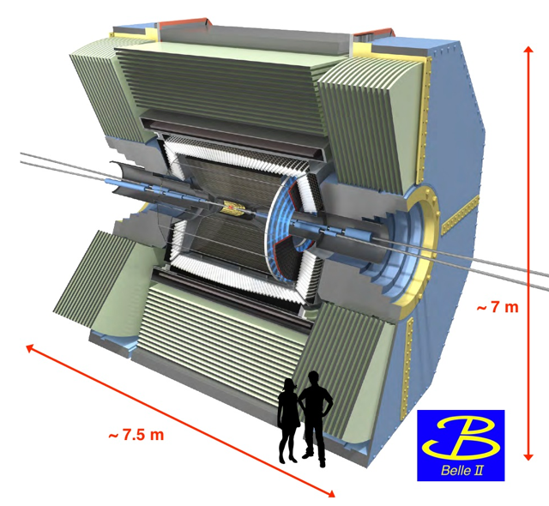
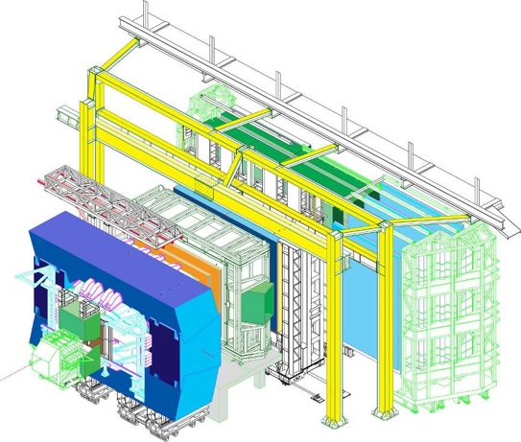


“B-physics” experiments
at the $e^{+}e^{−}→ Υ\left(4S\right) →b\overline{b}$ resonance
at high energy: $q\overline{q}/gg→b\overline{b}$
previously also: BaBar (at SLAC), CLEO (Cornell), ARGUS(DESY), …
previously also: Tevatron, SLD, LEP, …

Slide 8

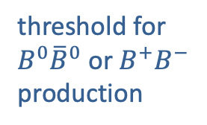
$Υ$ resonances: $b\overline{b}$ bound states
cross section for e+ e- to hadrons
threshold for
$B^{0}{\overline{B}}^{0}$ or $B^{+}B^{−}$ production

Slide 9
at 10.48 GeV:
$σ(B^{0}{\overline{B}}^{0})$ : $σ(B^{+}B^{−})$ : $σ($everything else) $=$ 1 : 1 : ~6

Slide 10
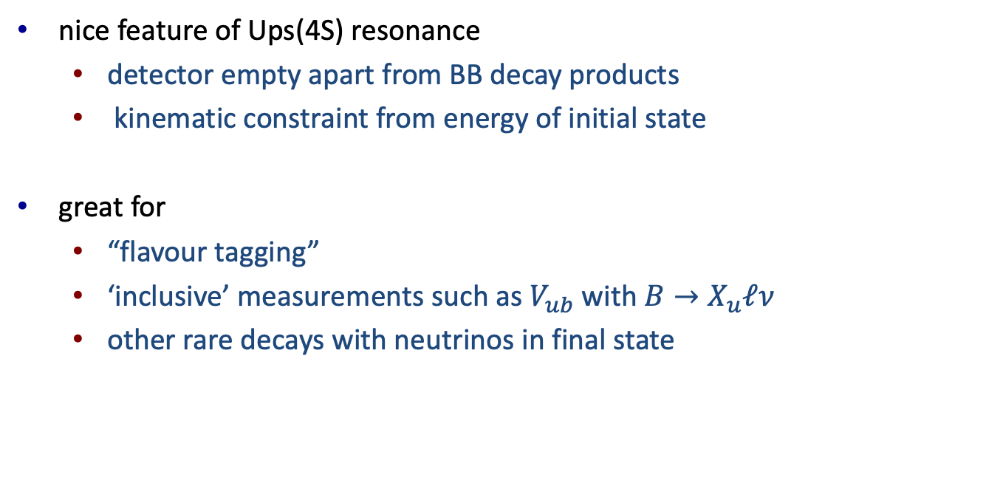
nice feature of Ups(4S) resonance
  detector empty apart from BB decay products
  kinematic constraint from energy of initial state
great for
  “flavour tagging”
  ‘inclusive’ measurements such as $V_{ub}$ with $B→X_{u}ℓν$
  other rare decays with neutrinos in final state

Slide 11
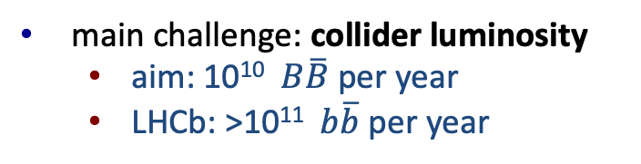
Belle-II at SuperKEKB
“asymmetric-energy collider”
to measure ‘decaytime’, B-mesons need to have non-zero velocity
achieved by using beams with different energy
electrons: ~7 GeV
positrons: ~4 GeV
main challenge: collider luminosity
  aim: 10¹⁰ $B\overline{B}$ per year
  LHCb: >10¹¹ $b\overline{b}$ per year

Slide 12
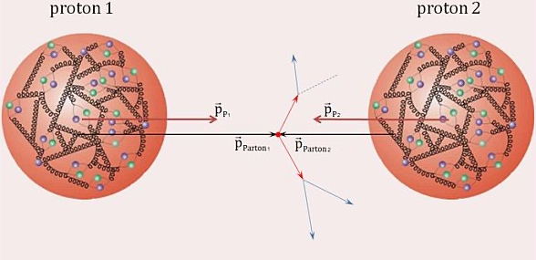
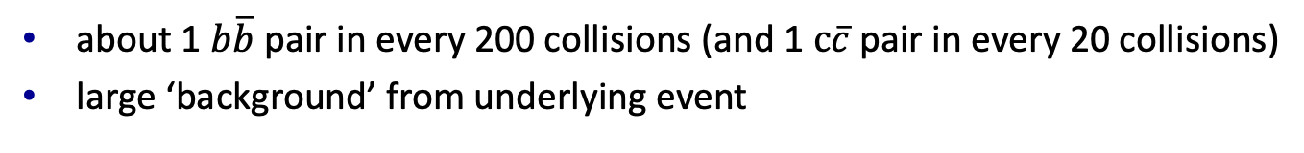
at the LHC: gluon-gluon fusion
dominant production mechanism is gluon-gluon fusion
about 1 $b\overline{b}$ pair in every 200 collisions (and 1 $c\overline{c}$pair in every 20 collisions)
large ‘background’ from underlying event

Slide 13
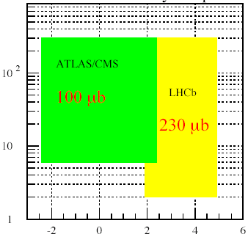
at the LHC: gluon-gluon fusion
b-quarks are light compared to LHC energy: strongly ‘boosted’
p_{T} of B-hadron
η of B-hadron
LHCb catches a larger fraction of B events
ATLAS/CMS have (much) larger primary interaction rates

Slide 14


Comparison of current B-physics experiments
$$e^{+}e^{−}→ Υ\left(4S\right)$$
at high energy: $q\overline{q}→b\overline{b}$
 | Belle-II | LHCb | ATLAS/CMS
clean events | yes | no | no
which B hadrons? | B0/B+ | all | all
decay time resolution | +++ (*) | +++ | ++
momentum resolution | +++ | +++ | ++
electron/muon ID | +++ | +++ | +++
kaon/pion/proton ID | +++ | +++ | +
these detectors were designed for flavour physics

Slide 15
Different detectors
Courtesy: N.Neri, IDPASC school, May 2013

Slide 16
the “impact parameter”
kaon
“impact parameter”
pion
~10mm
B decay vertex
(a.k.a. secondary vertex=SV)
pp interaction vertex
(a.k.a. primary vertex=PV)

Slide 17
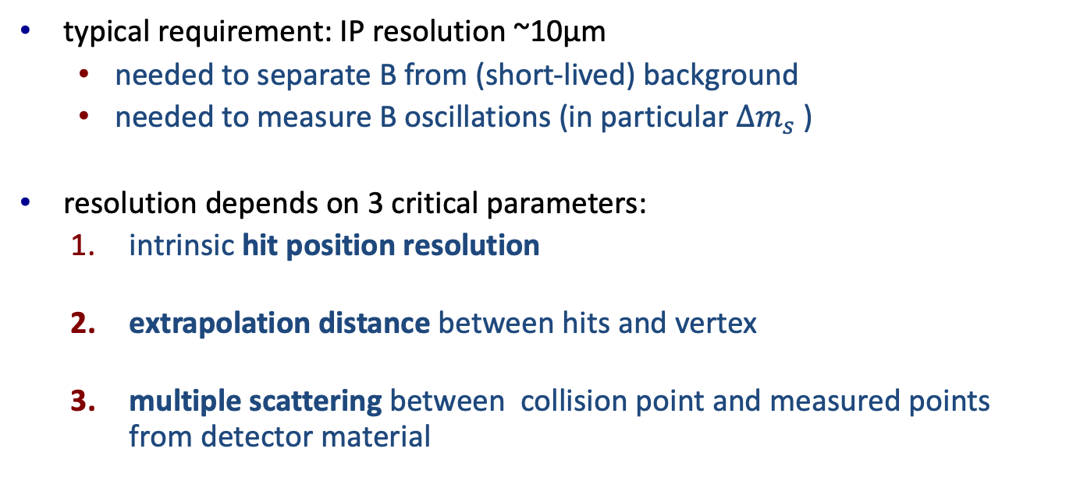
IP/decay time resolution
typical requirement: IP resolution ~10μm
  needed to separate B from (short-lived) background
  needed to measure B oscillations (in particular $Δm_{s}$ )
resolution depends on 3 critical parameters:
  intrinsic hit position resolution
  extrapolation distance between hits and vertex
  multiple scattering between collision point and measured points from detector material

Slide 18
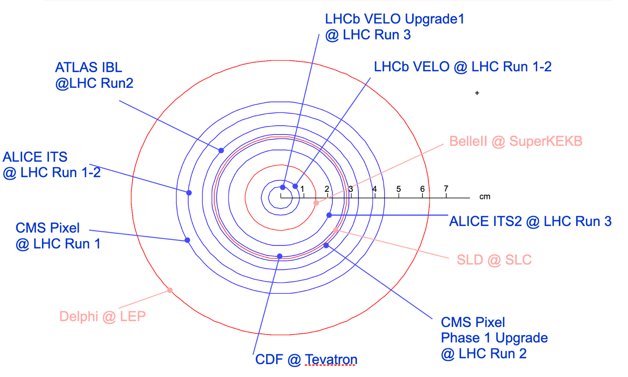
distance to vertex
resolution at LHCb:
σ(IP) ~10μm
σ(t) ~50fs
Fig.: Minimum radius of silicon vertex detectors at hadron and lepton colliders, up to start of LHC Run 3.
Courtesy: K.Akiba

Slide 19
LHCb secondary vertex performance: Decay time
Estimate decay time uncertainty from track parameters
Measure the resolution: calibration
“perfect”

Slide 20
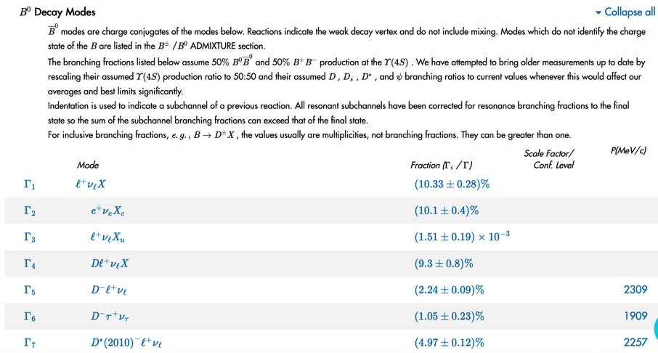
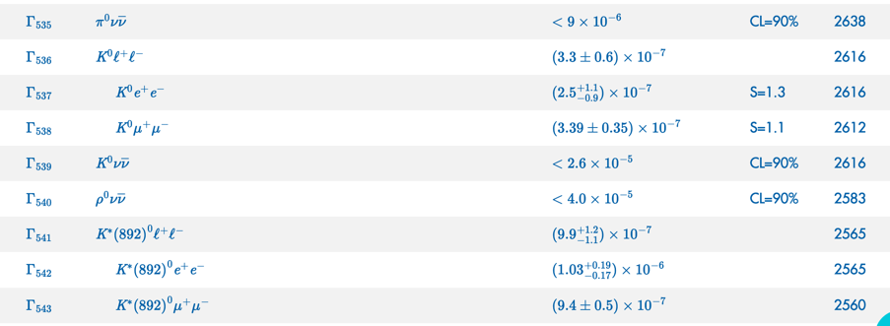
Particle identification
Many different B-decays!
  “BtooKstarpipiDsgamma”
  …
Need to distinguish:
  e, μ, γ, π, K, p, …

Slide 21
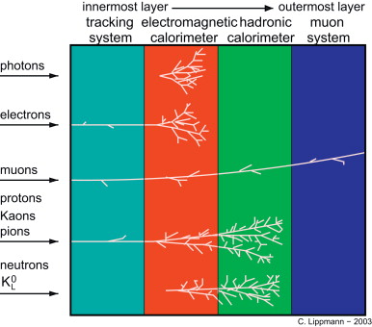
?

Slide 22
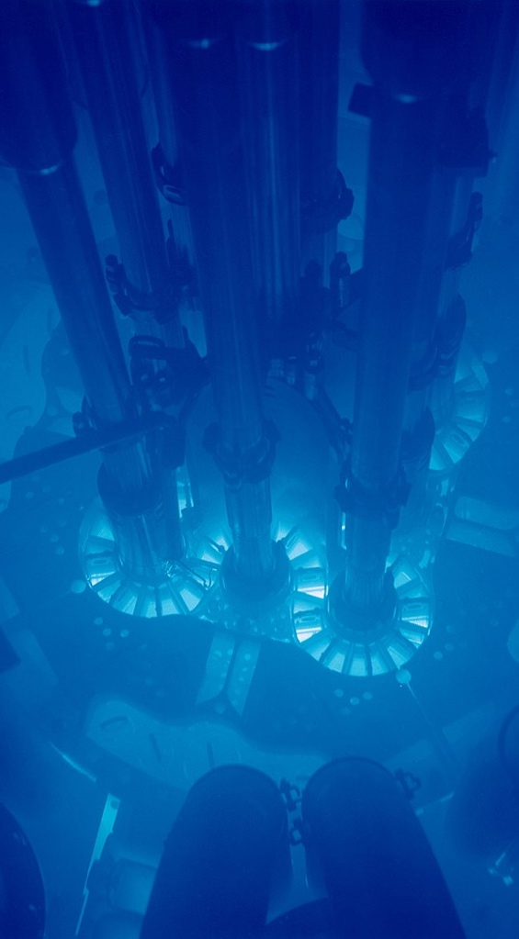
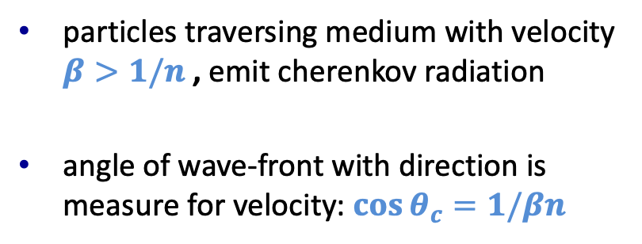
one solution: ring imaging cherenkov detector
particles traversing medium with velocity $β>1/n$ , emit cherenkov radiation
angle of wave-front with direction is measure for velocity: $\cos{θ_{c}=1/βn}$

Slide 23
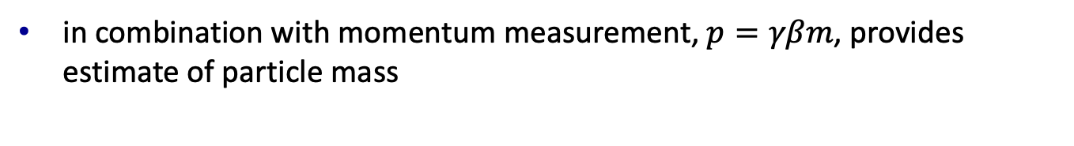
one solution: ring imaging cherenkov detector
in combination with momentum measurement, $p=γβm$, provides estimate of particle mass
different radiators suitable for different momentum range:
  Belle/Babar and LHCb make different choices

Slide 24
momentum resolution
momentum measured by ‘deflection’ (or ‘curvature’ or ‘sagita’)
detector resolution determined by
  “B-ΔL” : strength of magnetic field times detector ‘length’ (arm)
  hit resolution
  multiple scattering
different choices
  LHCb is forward detector with very long arm
  CMS/Belle-II have a strong superconducting magnet
note: Belle-II works with much lower momenta: need less ‘sagitta’ resolution for same momentum resolution, but suffers more from multiple scattering

Slide 25
Time-dependent CP-violation
will now discuss formalism of ‘time-dependent’ CP violation
very interesting method to probe ‘phases’ in Vckm with relatively small ‘hadronic’ uncertainties
will reuse mixing formalism discussed this morning, but also need to consider the ‘decay’ to the final state

Slide 26

Reminder: mixing formalism
This is what we found this morning
expressed in $m$, $Γ,$ $Δm,$ $ΔΓ$
next step: consider decay amplitude

Slide 27
Including decay amplitudes
consider decay of $B^{0}$ to final state ‘f’ accessible to both $B^{0}$and anti-$B^{0}$
computation needs to include the decay amplitudes

Slide 28
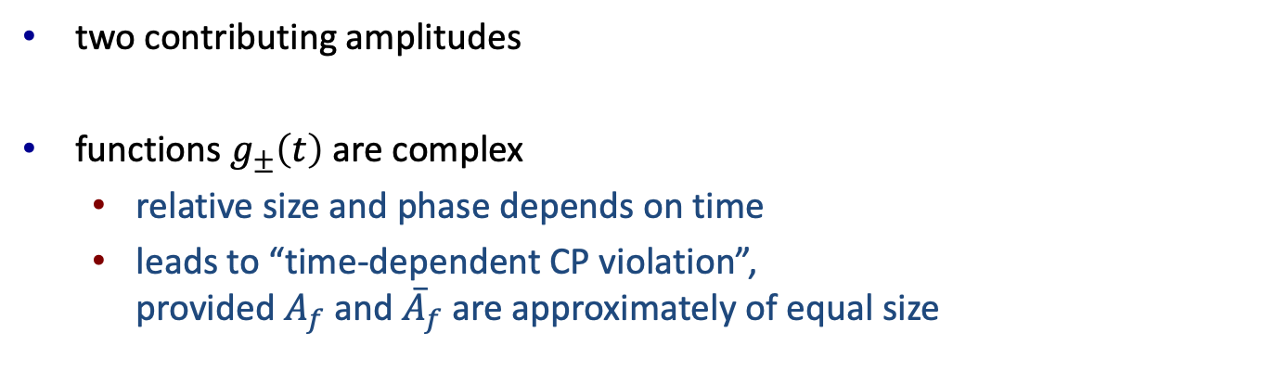
Time-dependent amplitude
if the meson started as a $B^{0}$, then time-dependent amplitude is
two contributing amplitudes
functions $g_{±}\left(t\right)$ are complex
  relative size and phase depends on time
  leads to “time-dependent CP violation”,
  provided $A_{f}$ and ${\overline{A}}_{f}$ are approximately of equal size

Slide 29
Time-dependent rate
next step: take the square of amplitude:
taking the square gives
where we defined the “lambda” parameter:

Slide 30


Time-dependent rate
next step: take the square of amplitude:
taking the square gives
$$B^{0}→f$$
$$B^{0}→\overline{B^{0}}→f$$
interference

Slide 31
Time-dependent rate
now substitute the functions g
after some straightforward but time-consuming algebra:
interference terms
with

Slide 32
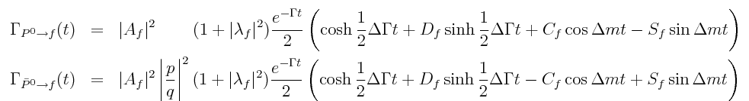
Time-dependent rate for anti-B0 to f
expression for anti-B0 to f follows with substitution
together, expressions then look like
these terms change sign
with

Slide 33
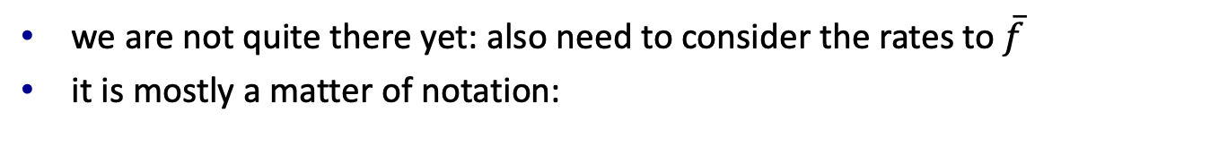
Rates to CP-conjugate final state
we are not quite there yet: also need to consider the rates to $\overline{f}$
it is mostly a matter of notation:
note: if there is no CP violation in the decay, then

Slide 34
Two important cases
case 1: f is flavour-specific final state
  example: B0 -> J/psi K*, but many others
case 2: f is CP eigenstate with only single contributing amplitude
  example B0 -> J/psi Ks and Bs -> J/psi phi (“golden modes”)

Slide 35
Two important cases
case 1: f is flavour-specific final state
  this is how we measure mixing frequency
  example: B0 -> J/psi K*, but many others

Slide 36
Two important cases
case 2: f is CP eigenstate with only single contributing amplitude
mixing phase
phase from decay:

Slide 37
Two important cases
case 2: f is CP eigenstate with only single contributing amplitude
|q/p|=1, ΔΓ=0
  this measures CKM phases → “angles of unitarity triangle”
  example B0 -> J/psi Ks and Bs -> J/psi phi (“golden modes”)

Slide 38

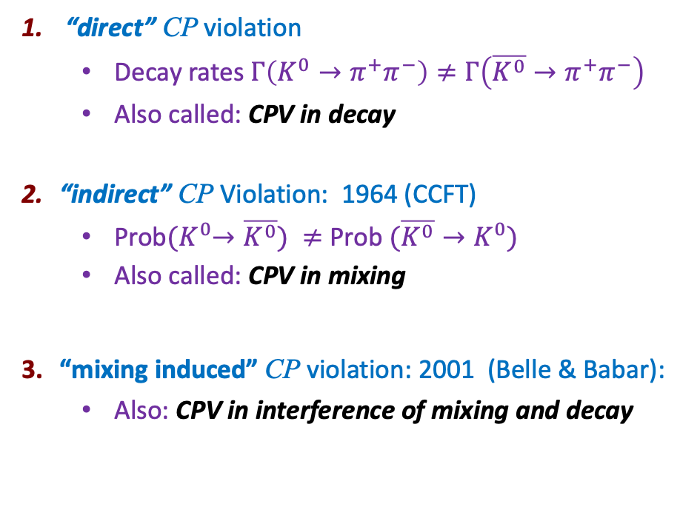

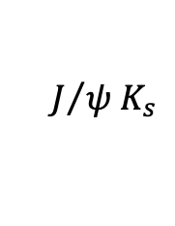


Three types of CP violation
35
  “direct” CP violation
    Decay rates $Γ\left(K^{0}→π^{+}π^{−}\right)≠Γ\left(\overline{K^{0}}→π^{+}π^{−}\right)$
    Also called: CPV in decay
  “indirect” CP Violation: 1964 (CCFT)
    Prob${(K}^{0}→\overline{K^{0}}) ≠$ Prob $(\overline{K^{0}}→K^{0})$
    Also called: CPV in mixing
  “mixing induced” CP violation: 2001 (Belle & Babar):
    Also: CPV in interference of mixing and decay
Interfere decay amplitudes:
Interfere dispersive and absorptive:
$$K^{0}$$
$$\overline{K^{0}}$$
Interfere direct and mixed:
$$B$$
$$J/{ψ{ K}_{s}}$$
$$\overline{B}$$

Slide 39

Example: $B^{0}→J/ψ$ $K_{S}$

Slide 40
Example: $B^{0}→J/ψ$ $K_{S}$

Slide 41
Example: $B^{0}→J/ψ$ $K_{S}$
to get the interference, also need
to take into account K0-K0bar mixing

Slide 43

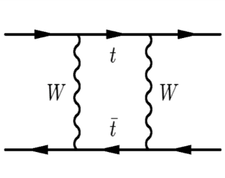
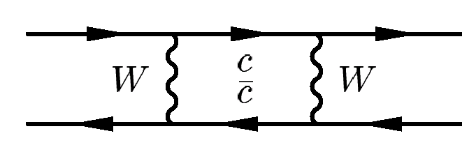
λ_{f} for B⁰ → J/ψK⁰_{S}
d
b
b
d
d
s
s
d
Notes:
|Vcs Vcd|^2 mc^2 = (1*lambda)^2 mc^2 vs. |Vts Vtd|^2 mt^2 = (lambda^2*lambda^3)^2 mt^2 → suppressed by lambda^8, enhanced by (mt/mc)^2 << 1

Slide 44
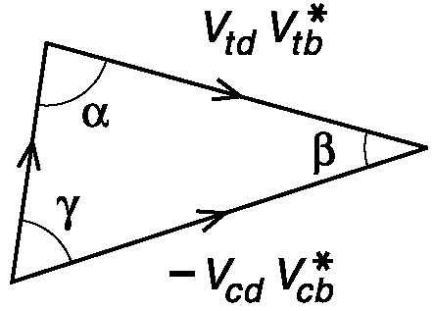
λ_{f} for B⁰ → J/ψK⁰_{S}
Time-dependent CP asymmetry
Theoretically clean way to measure β
Clean experimental signature
Branching fraction: O(10⁻⁴)
    “Large” compared to other CP modes!
Notes:
|Vcs Vcd|^2 mc^2 = (1*lambda)^2 mc^2 vs. |Vts Vtd|^2 mt^2 = (lambda^2*lambda^3)^2 mt^2 → suppressed by lambda^8, enhanced by (mt/mc)^2 << 1

Slide 45
Exercises
see README.md file at
now: exercises 8-9
(my apologies: still need to finish notebook for exercise 10)
  https://github.com/wouterhuls/FlavourPhysicsBND2023/

Slide 46
backup

Slide 47
Computation of M_12 and G_12
all ‘virtual’ quarks
contribute
only states with sufficiently small mass contribute

Slide 48
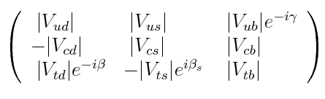

Slide 49
Illustration of computation of M_12
Amplitude for free quarks
  CKM factors
  quark masses
2. Hadronic corrections

Slide 50
Illustration of formula for M_12
Amplitude for free quarks
  CKM factors
  quark masses
2. Hadronic corrections

Slide 51
Illustration of formula for M_12
for different mesons, different quarks ‘dominate’ inside the loop
e.g. for B mesons, the top quark dominates:
CKM phase of M_12: we’ll need this later on

Slide 52
Illustration of computation for G_12
this if for B mesons as well:
top doesn’t actually contribute:
this uses unitarity to replace phase of
up quark contribution
to take away from this
  computations are very hard work
  only source of phases are CKM phases
  uncertainty on size and phase of M_12/G_12 reasonably small

